Slide 1
Listening and integrated skills A2
Instructor: Nguyen Ha Phuong

Slide 2
Unit 8: Learn to love art
Pages 141-160

Slide 3
Lesson objectives
By the end of the lesson, students will be able to:
respond to an academic discussion about temporary art.
listen to biographical information about a musician and make suggestions about art to enjoy.
use collocations with prepositions.
recognize opinions.
synthesize information.
recognize connected speech

Slide 4
TABLE OF CONTENTS
01
02
03
04
05
VOCABULARY A
LISTENING A
VIDEO WATCHING
VOCABULARY B
LISTENING B

Slide 5
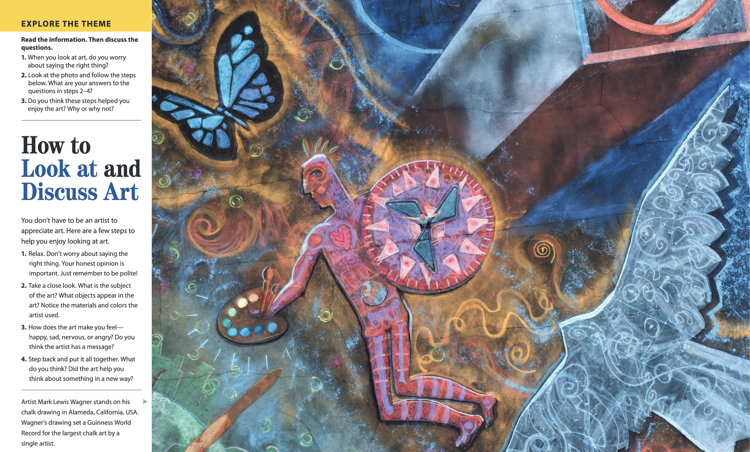

Slide 6

01
Vocabulary A

Slide 7
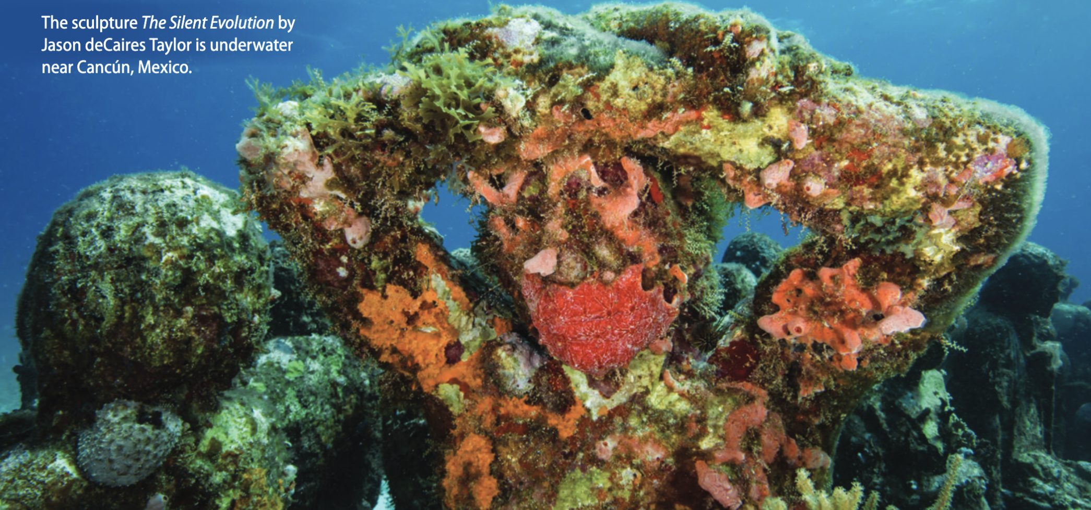
What questions come to mind when you look at this?

Slide 8

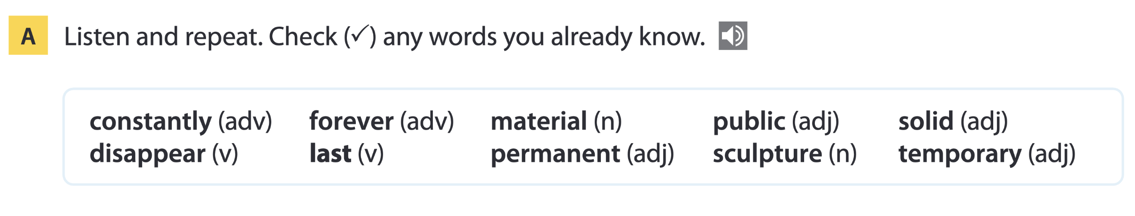
Page 144

Slide 9
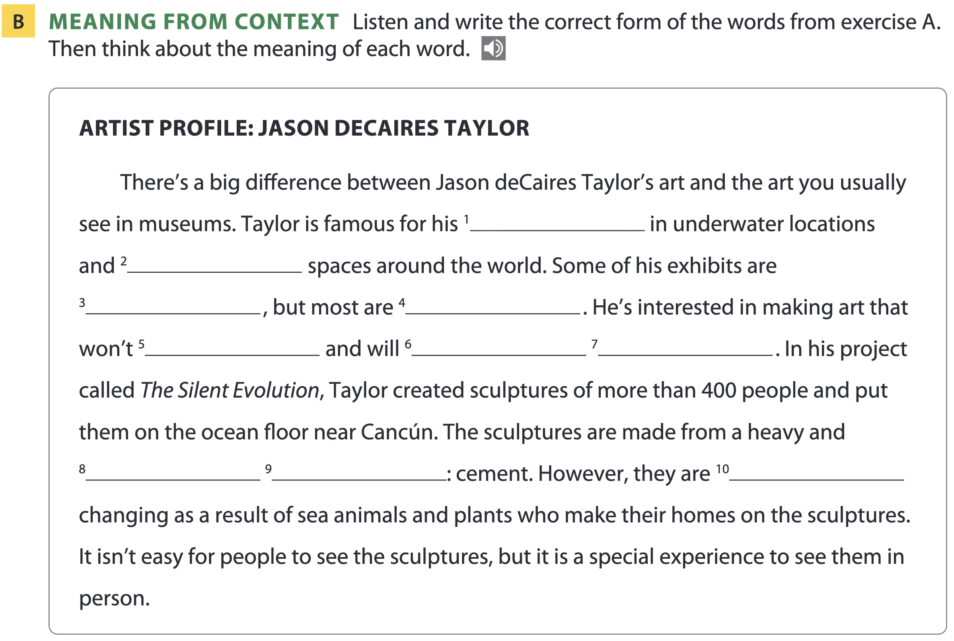
Page 144
sculptures
public
temporary
permanent
disappear
last
forever
solid
material
constantly

Slide 10
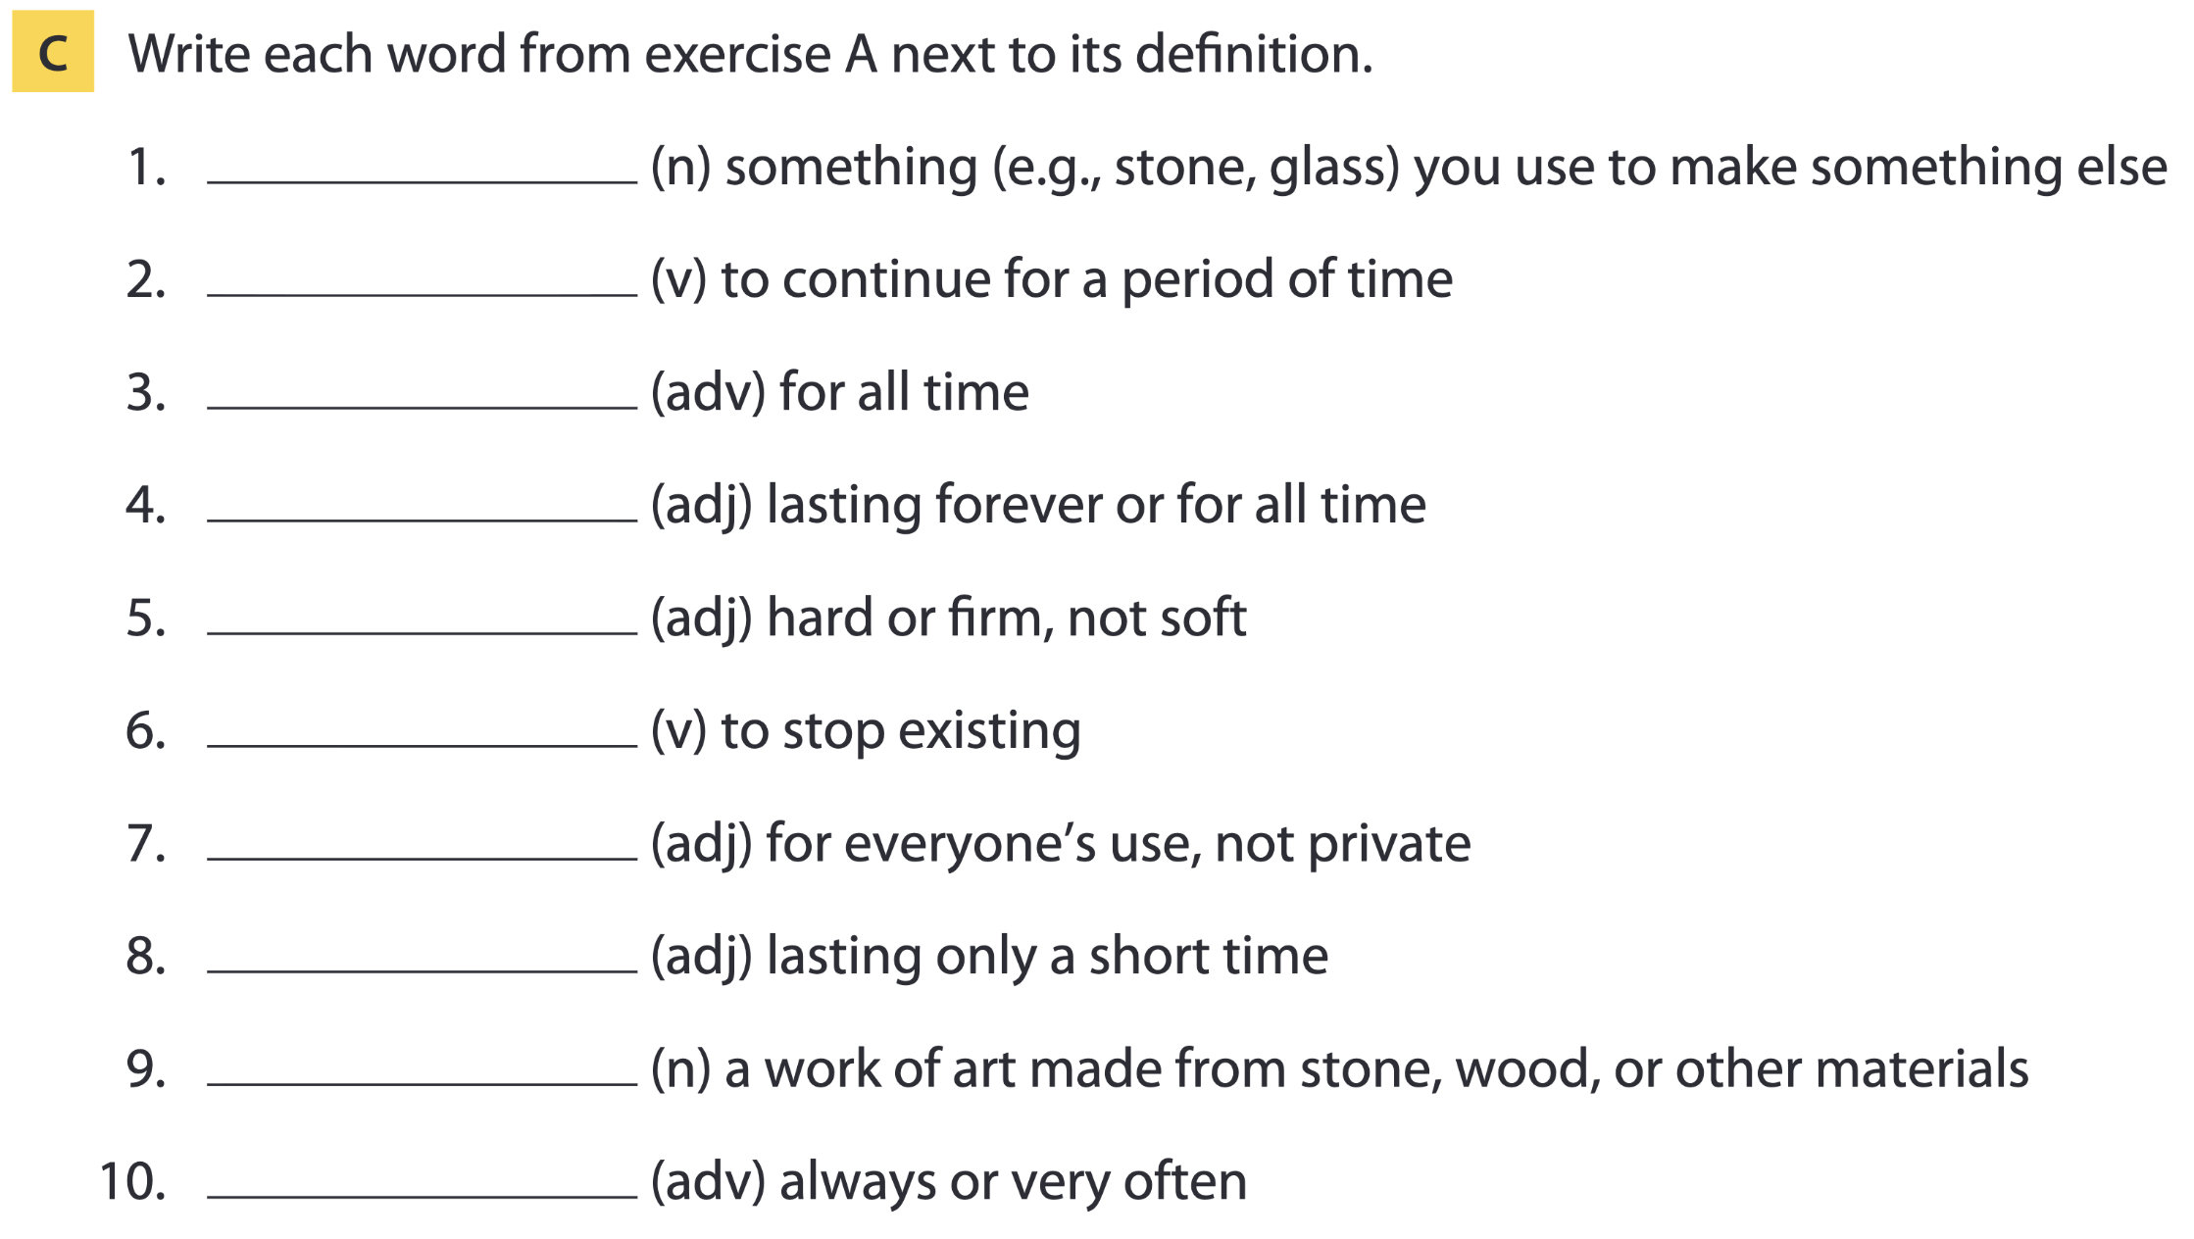
Page 144
material
last
forever
permanent
solid
disappear
public
temporary
sculpture
constantly

Slide 11
Word list
material /məˈtɪəriəl/ (n): nguyên liệu, chất liệu
last /lɑːst/ (v): kéo dài
forever /fəˈrevə(r)/ (adv): mãi mãi
permanent /ˈpɜːmənənt/ (adj): vĩnh viễn, lâu dài
solid /ˈsɒlɪd/ (adj): rắn chắc, cứng
disappear /ˌdɪsəˈpɪə(r)/ (v): biến mất
public /ˈpʌblɪk/ (adj): công cộng, chung
temporary /ˈtemprəri/ (adj): tạm thời
sculpture /ˈskʌlptʃə(r)/ (n): tác phẩm điêu khắc
constantly /ˈkɒnstəntli/ (adv): liên tục, thường xuyên

Slide 12
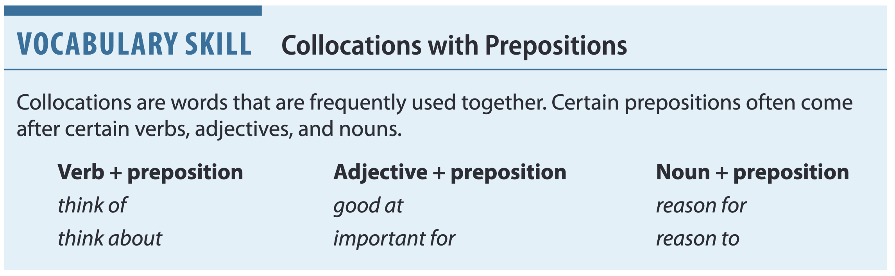
Page 145
Practice: Choose the correct preposition to complete each sentence:
I need to think _______ this some more.
I’m good _______ photography.
There’s no reason _______ stop now.
about
at
to

Slide 13
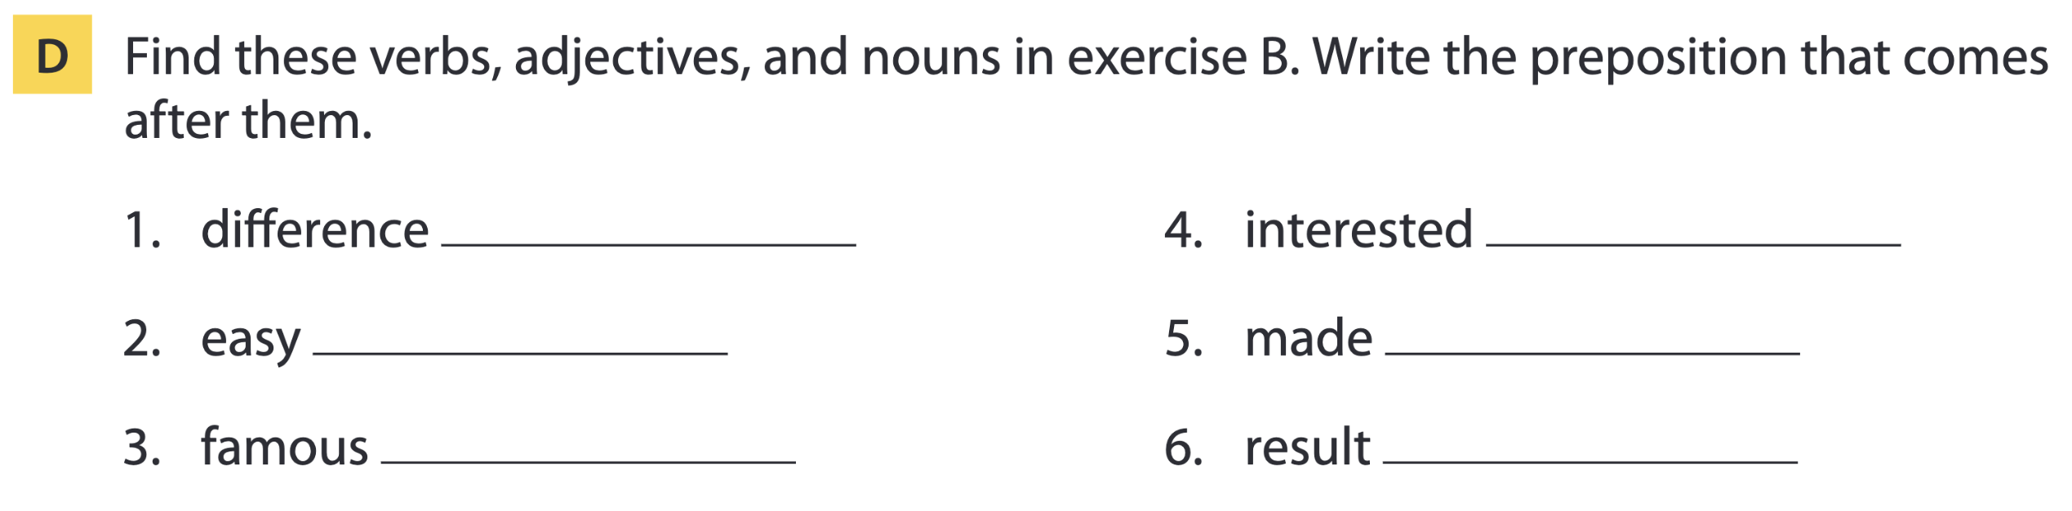
Page 145
between
in
for
from
for
of

Slide 14
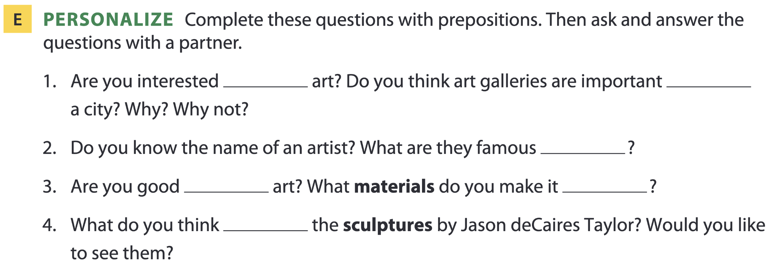
Page 145
in
for
for
at
from
of

Slide 15

02
Listening A

Slide 16
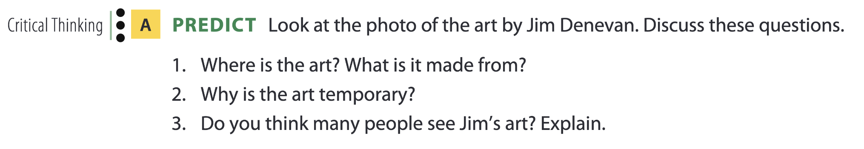
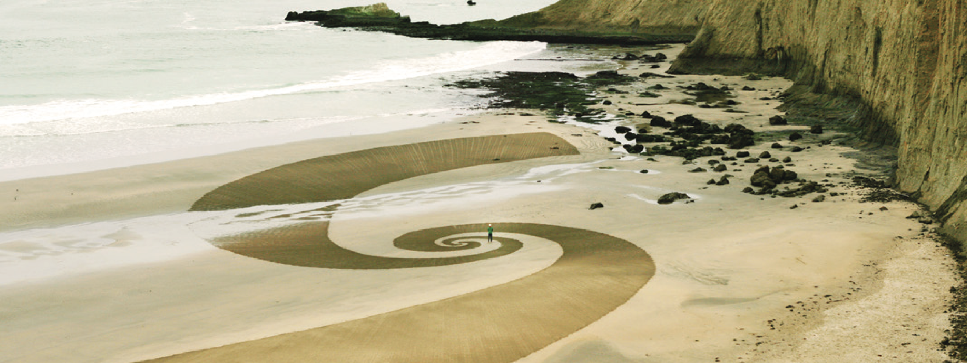
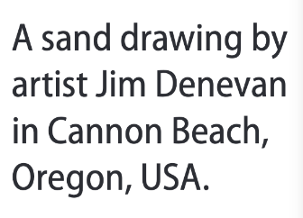
Temporary art

Slide 17
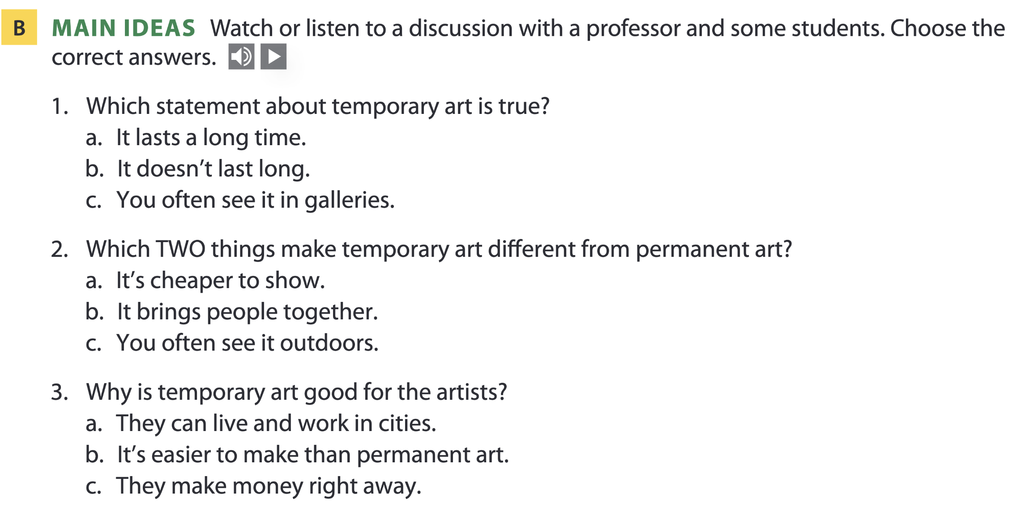
Page 146

Slide 18
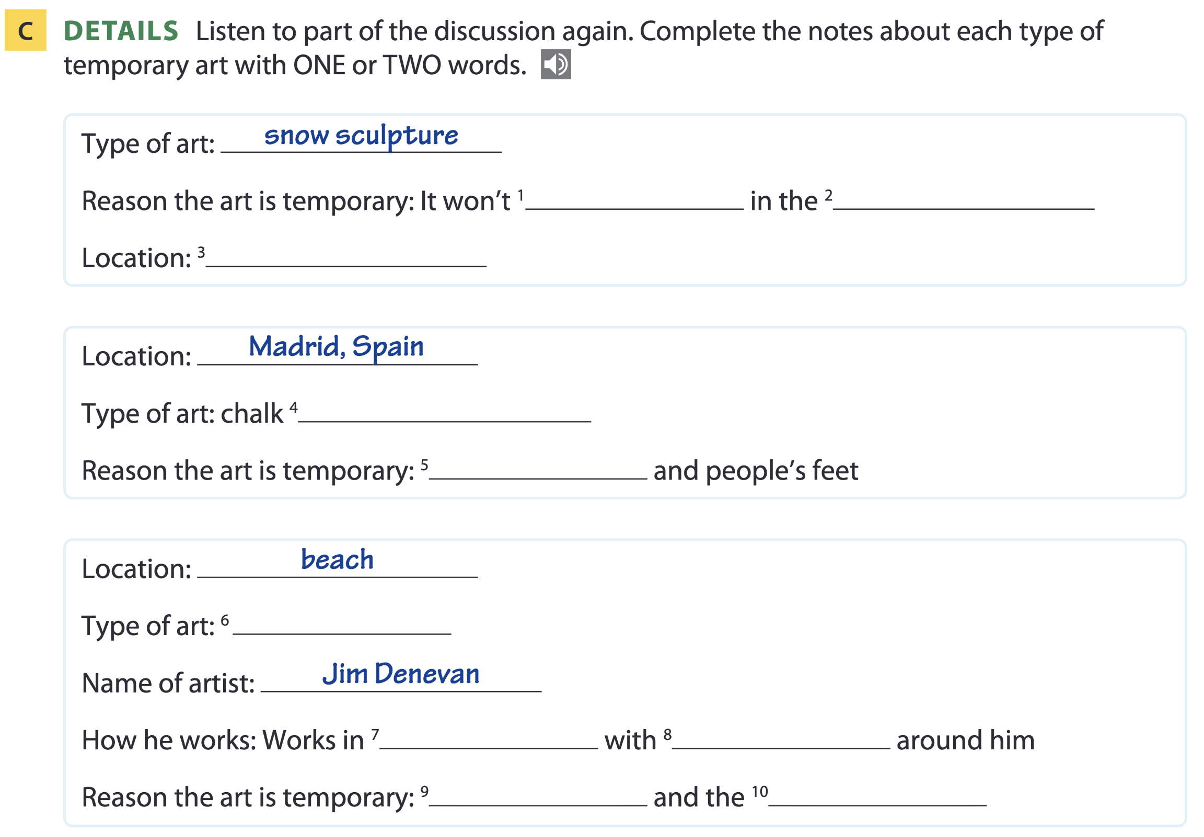
Page 146
last
heat
Montreal, Canada
drawing / painting
rain
sand art
nature
materials
sea
weather

Slide 19
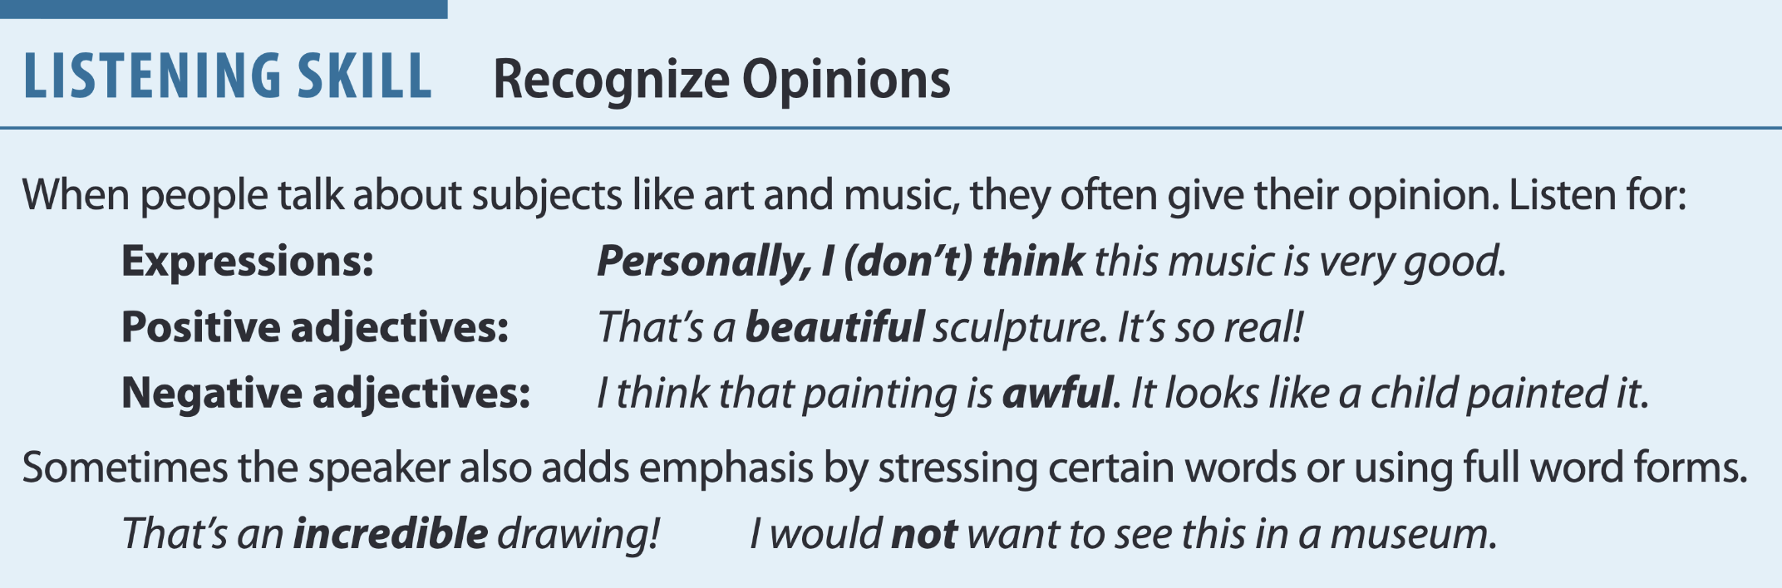
Page 147

Slide 20
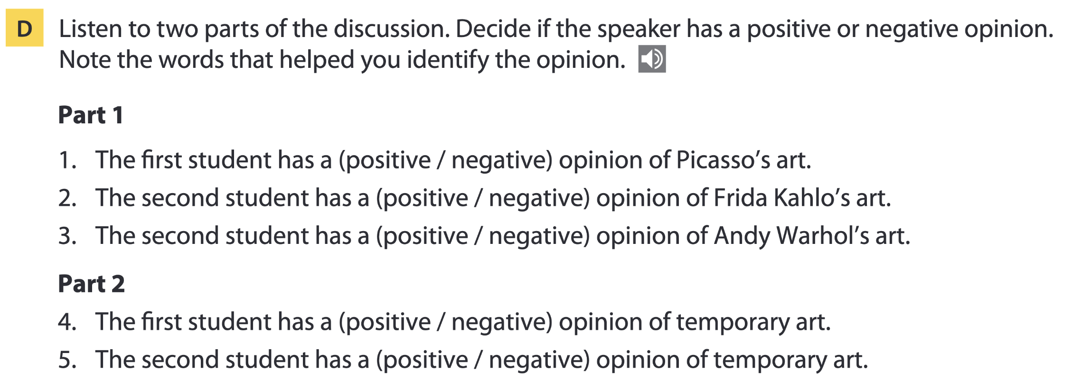
Page 147
1. amazing (paintings and sculptures)
2. wonderful (colors)
3. I do not think his work is interesting.
4. boring; I do not want to pay money (to see it).
5. Personally, I really like it.

Slide 21
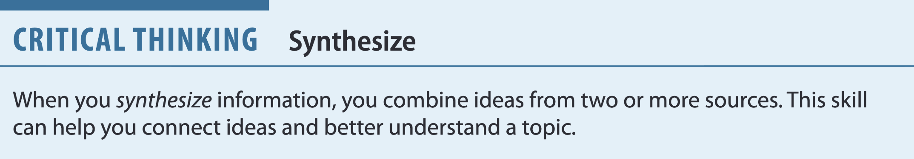
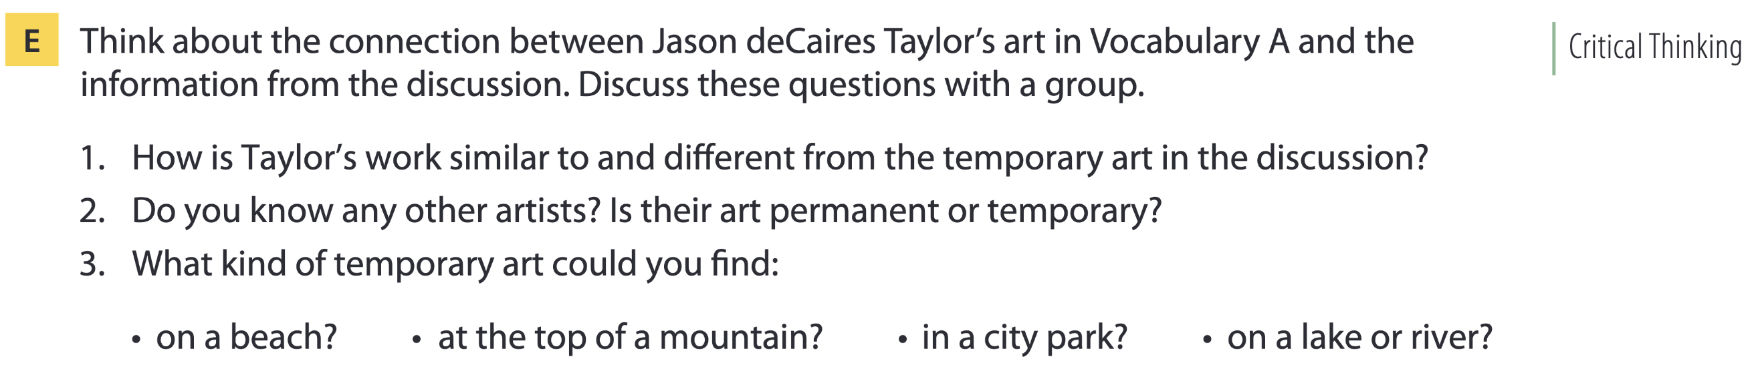
Page 147

Slide 22
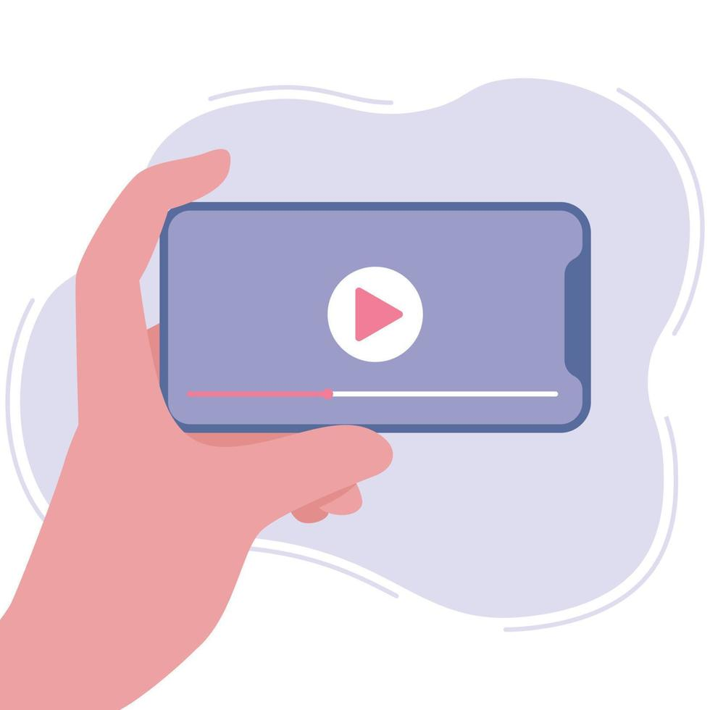
03
Video watching

Slide 23
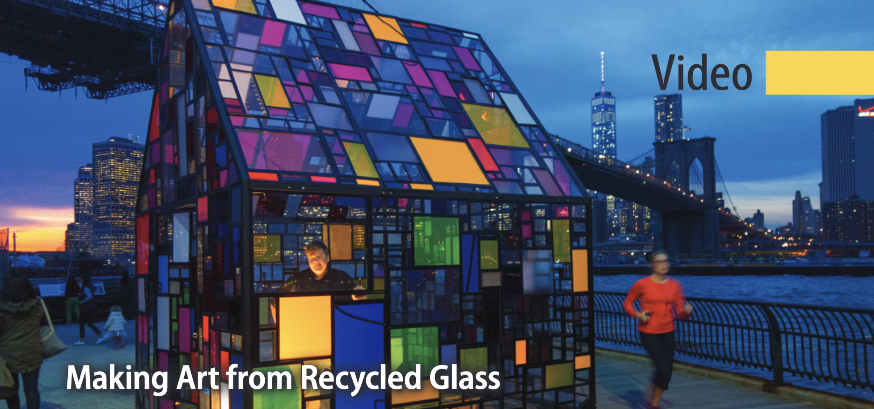
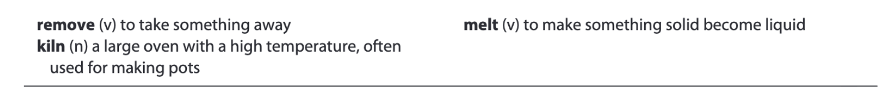
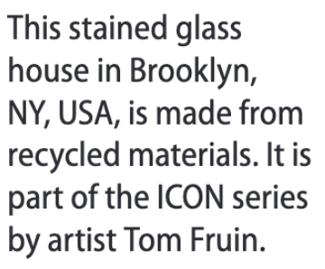
Page 151

Slide 24
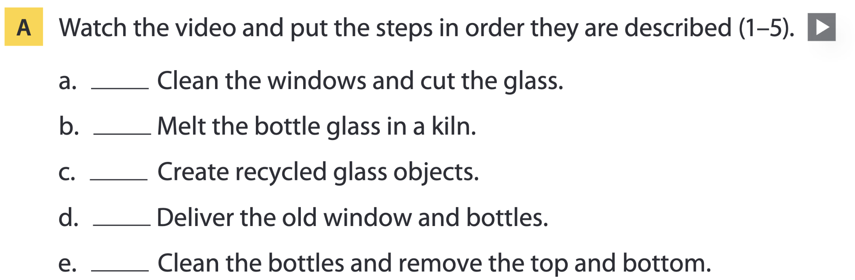
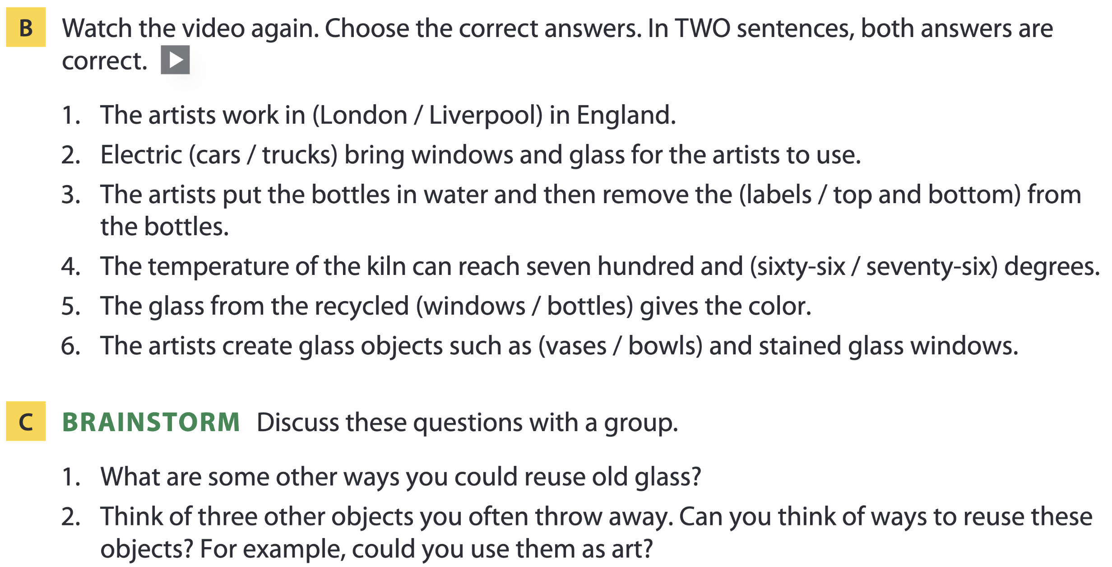
Page 151
4
3
5
1
2

Slide 25
04
Vocabulary B

Slide 26
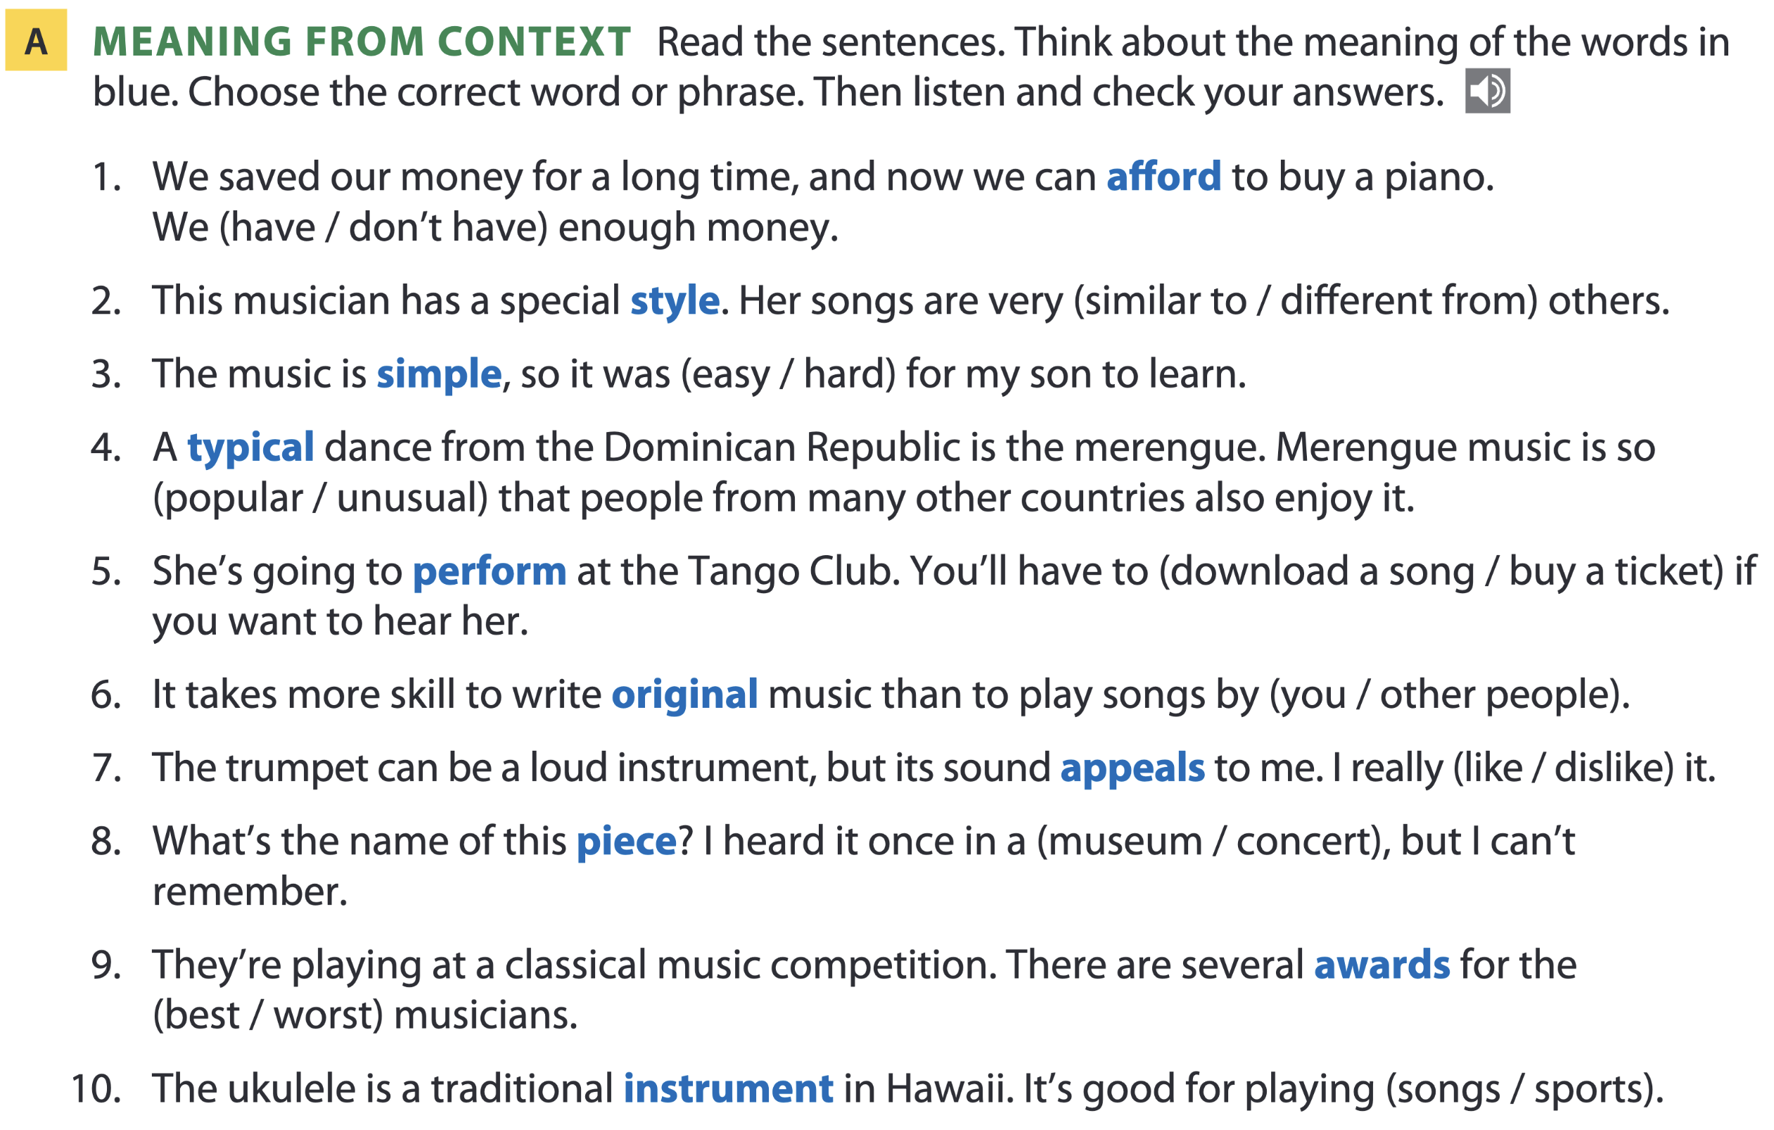
Page 152

Slide 27
Word list
afford /əˈfɔːd/ (v): có đủ khả năng (về thời gian hoặc tiền bạc) để làm gì
style /staɪl/ (n): phong cách
simple /ˈsɪmpl/ (adj): đơn giản
typical /ˈtɪpɪkl/ (adj): tiêu biểu, điển hình
perform /pəˈfɔːm/ (v): biểu diễn, trình diễn
original /əˈrɪdʒənl/ (adj): nguyên bản, độc đáo
appeal /əˈpiːl/ (v): thu hút, lôi cuốn
piece /piːs/ (n): tác phẩm (nghệ thuật, âm nhạc...)
concert /ˈkɒnsət/ (n): buổi hòa nhạc
award /əˈwɔːd/ (n): giải thưởng
instrument /ˈɪnstrəmənt/ (n): nhạc cụ

Slide 28
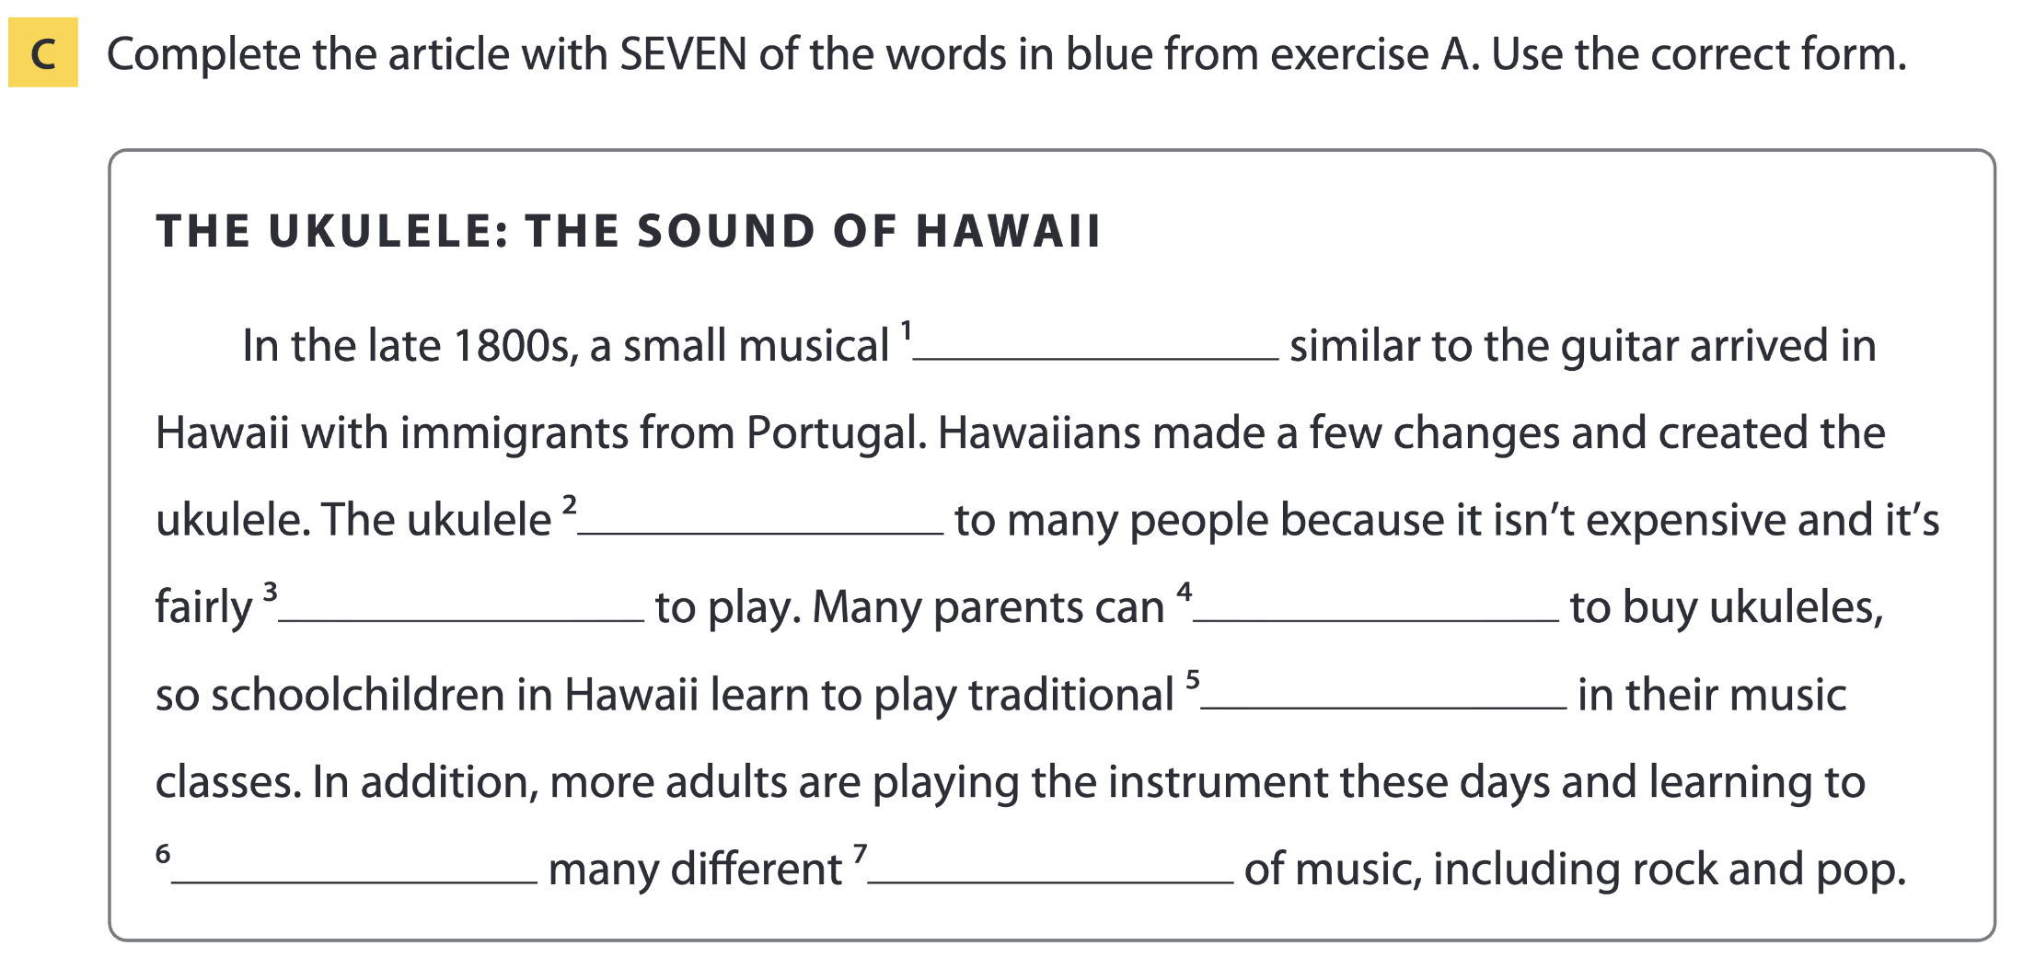
Page 153
instrument
appeals
simple
afford
pieces
perform
styles

Slide 29
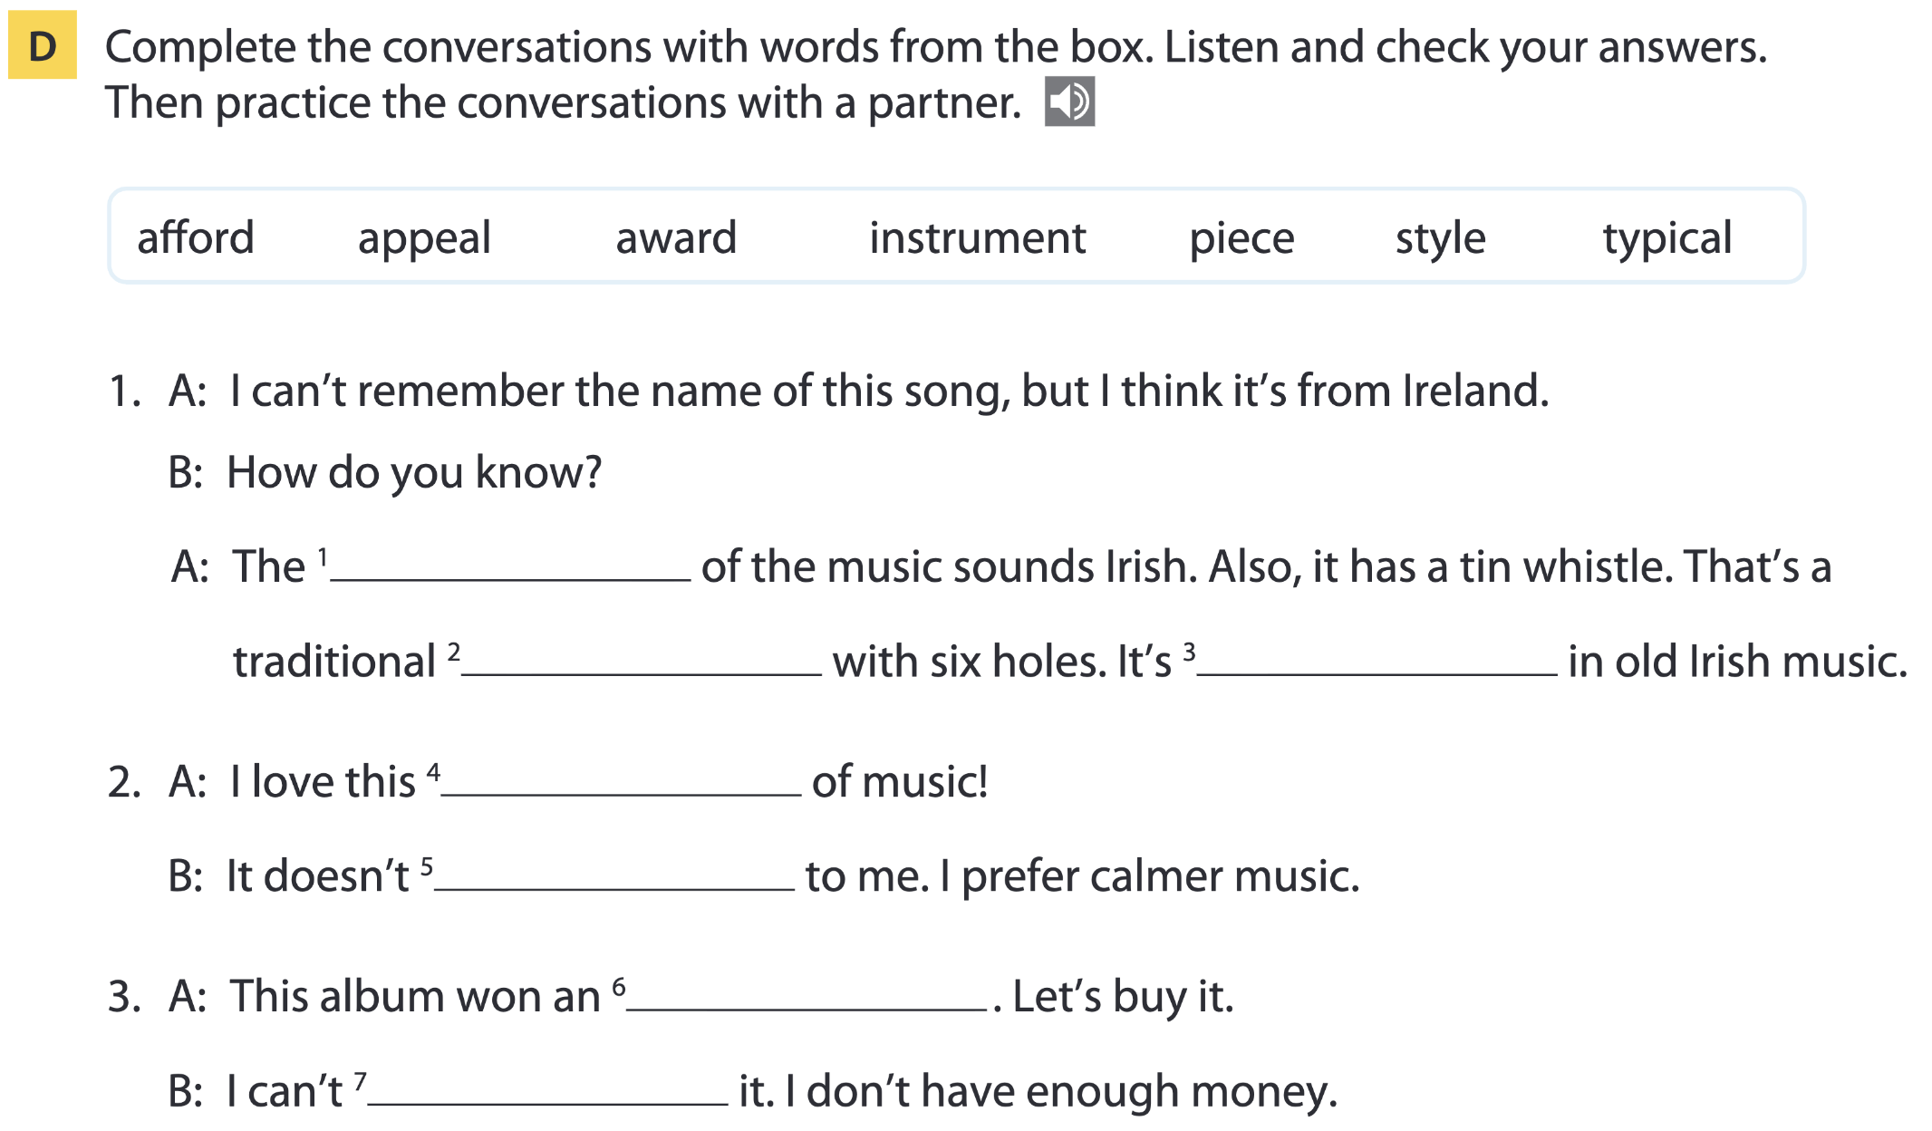
Page 153
style
instrument
typical
piece
appeal
award
afford

Slide 30
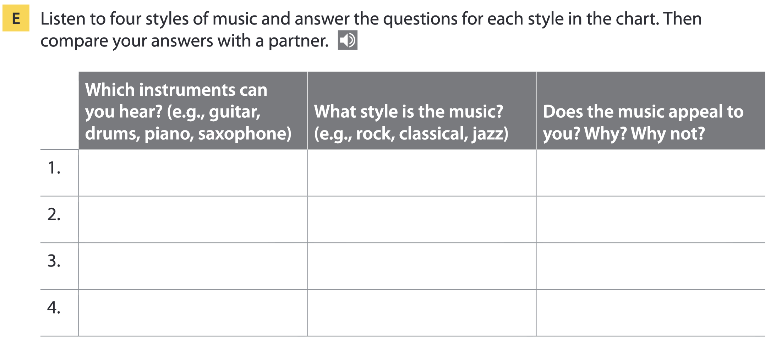
Page 153
piano classical
ukulele Hawaiian
saxophone jazz
guitar/drums rock

Slide 31
05
Listening B

Slide 32
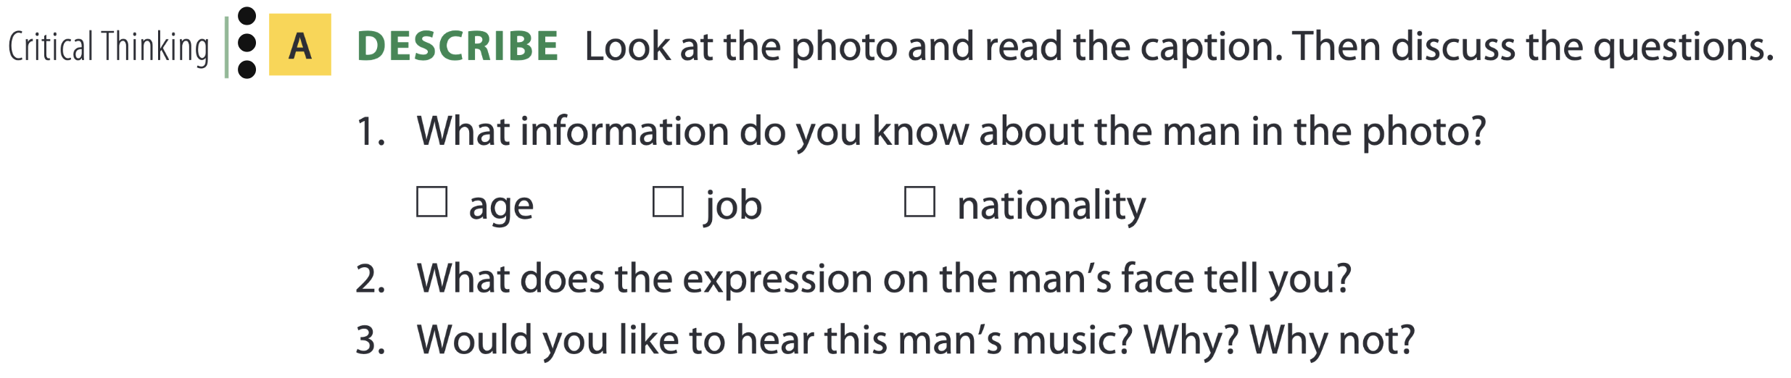

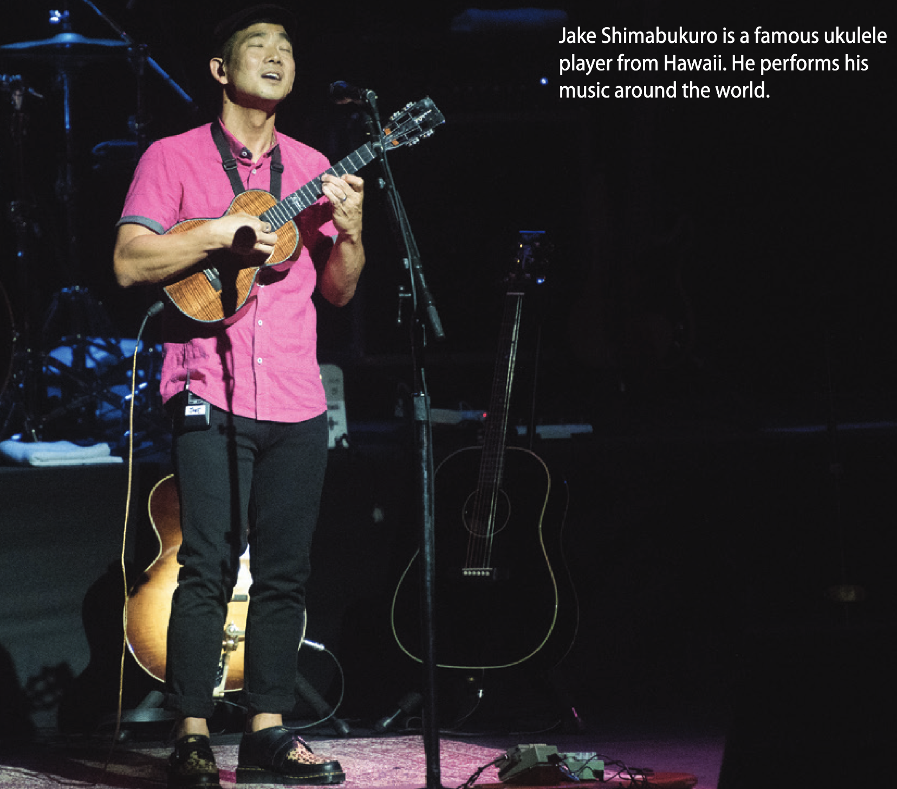
Jake Shimabukuro

Slide 33
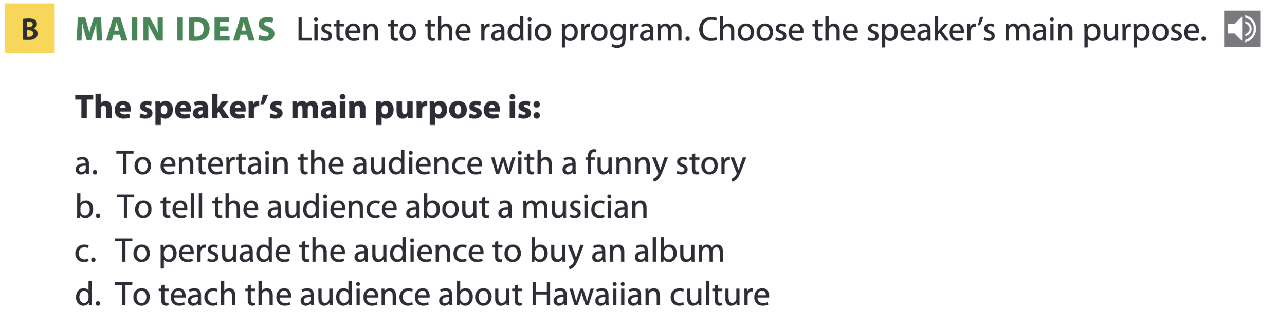
Page 154

Slide 34
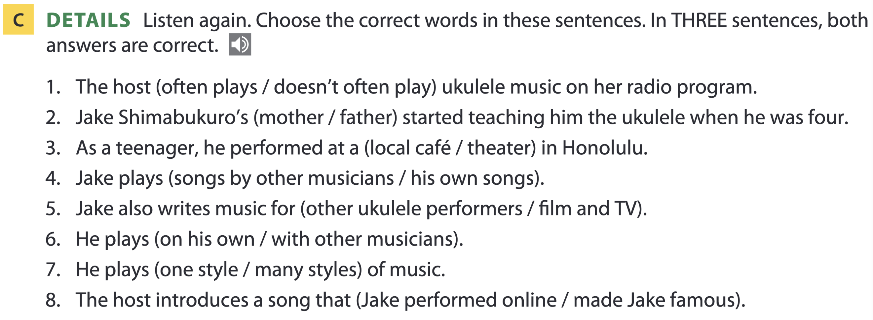
Page 154

Slide 35
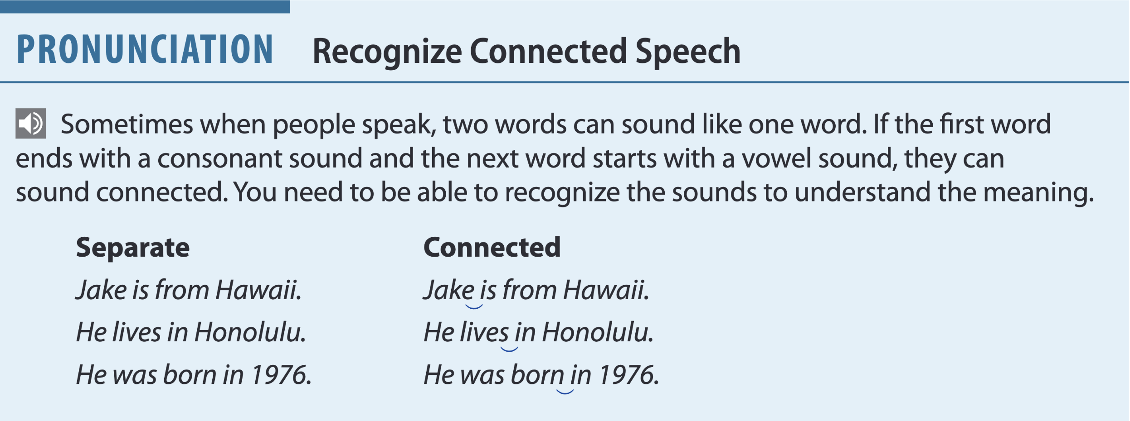
Page 154
Sound like:
“Jakis”
“livesin”
“bor-nin”

Slide 36
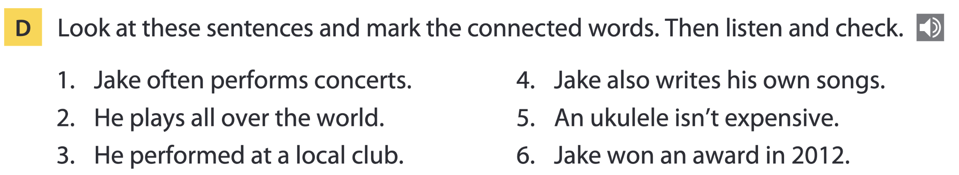
Page 155

Slide 37
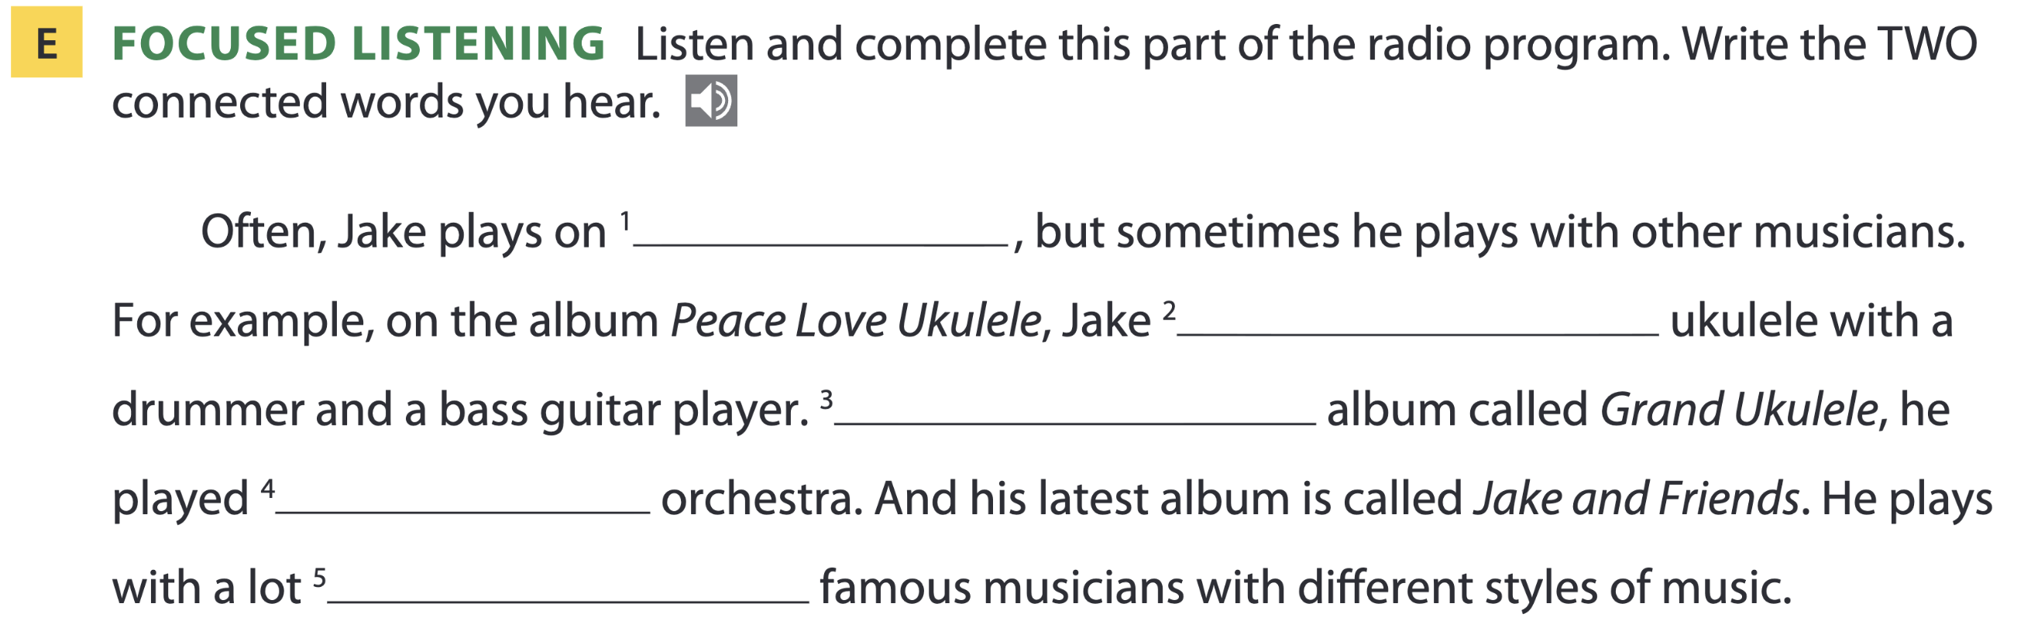
Page 155
his own
played his
On another
with an
of other

Slide 38
THANKS FOR YOUR ATTENTION!

